Slide 1
Lithosphere

Slide 2
Overview of the Lecture
Size and shape of the Earth
Earths structure
Core
Mantle
Crust
Composition of Earths Crust
Plates
Plate Boundaries
Biosphere

Slide 3
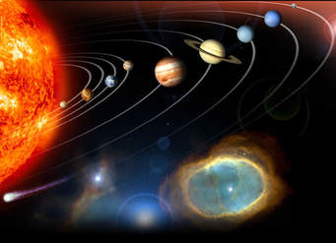
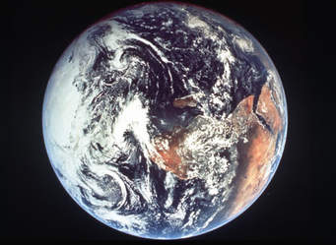
Size and Shape of the Earth
The Earth has a surface area of 510 million km²
It is an oblate spheroid
The study of the shape of the earth is called Geodesy
Modern geodesic survey is greatly assisted by developments in remote sensing

Slide 4
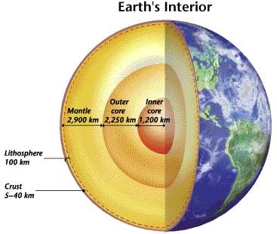

Slide 5
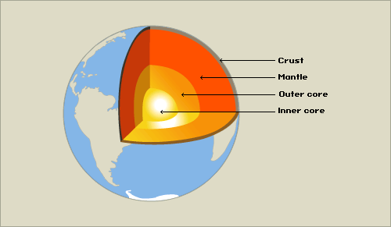
Earth’s Structure
Earth’s internal zones:
Core
- Inner core
- Outer core
Mantle
Crust
- Oceanic crust
- Continental crust

Slide 6
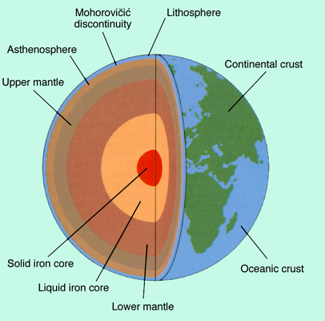
Figure: Structure of the Earth

Slide 7
Core
The inner most part of the earth
Temperature of the centre of the core is between 4000⁰C & 5000⁰C.
This part is composed of iron, nickel & cobalt & known as Nife.
Density is very high
It has two layers
a liquid exterior-outer core- 2250 km (thickness)-made of liquid Fe, Ni
a solid interior-inner core-1200 km (thickness)-made of solid Fe, Ni

Slide 8
Mantle
- layer between the core & the crust
a thick layer (2900 km) of mostly molten rock
Lithosphere: The outer part of the mantle is rigid and behaves as a solid and this layer mostly merges with the crust. Lithosphere consist of the crust and part of upper mantle, which is about 100 km thick. The lithosphere is the earth’s solid crust and upper mantle. Lithosphere contains non-renewable fossil fuels and minerals we use as well as renewable soil chemicals that organisms need to live, grow and reproduce.
Asthenosphere: The layer just beneath the lithosphere is known as asthenosphere. Its materials behave more like flowing plastic than solid rock and is about 200 km thick.

Slide 9
Crust
the outer shell of the earth which varies in thickness from 5-50 km.
It is solid & generally consists of low density materials
May be divided into two parts
upper crust/continental crust- up to 100 km thick under the mountains
lower crust/oceanic crust- only 5 km thick under the oceans
The upper crust is also known as ‘sial’ as rocks of this part is composed mainly of silica & aluminium.
The lower crust is called ‘sima’ as silica & magnesium are the most common minerals here.

Slide 10
Composition of Earth’s Crust
Only 8 elements make up 99% of the weight of Earth’s crust. These are, in order of abundance,
Oxygen 47%
Silicon 28%
Aluminum 8%
Iron 5%
Calcium 4%
Sodium 3%
Potassium 2%
Magnesium 2%
All other elements make up only 1% of the weight of Earth’s crust.

Slide 11
Plates & Plate Tectonics
Plates: Various-sized areas of Earth’s lithosphere that moves slowly around on the mantle’s flowing asthenosphere
Earthquakes and volcanoes occur around the boundaries of these plates
Plate tectonics: Theory of geophysical processes that explains the movements of Earth’s plates and the processes that occur at their boundaries

Slide 12
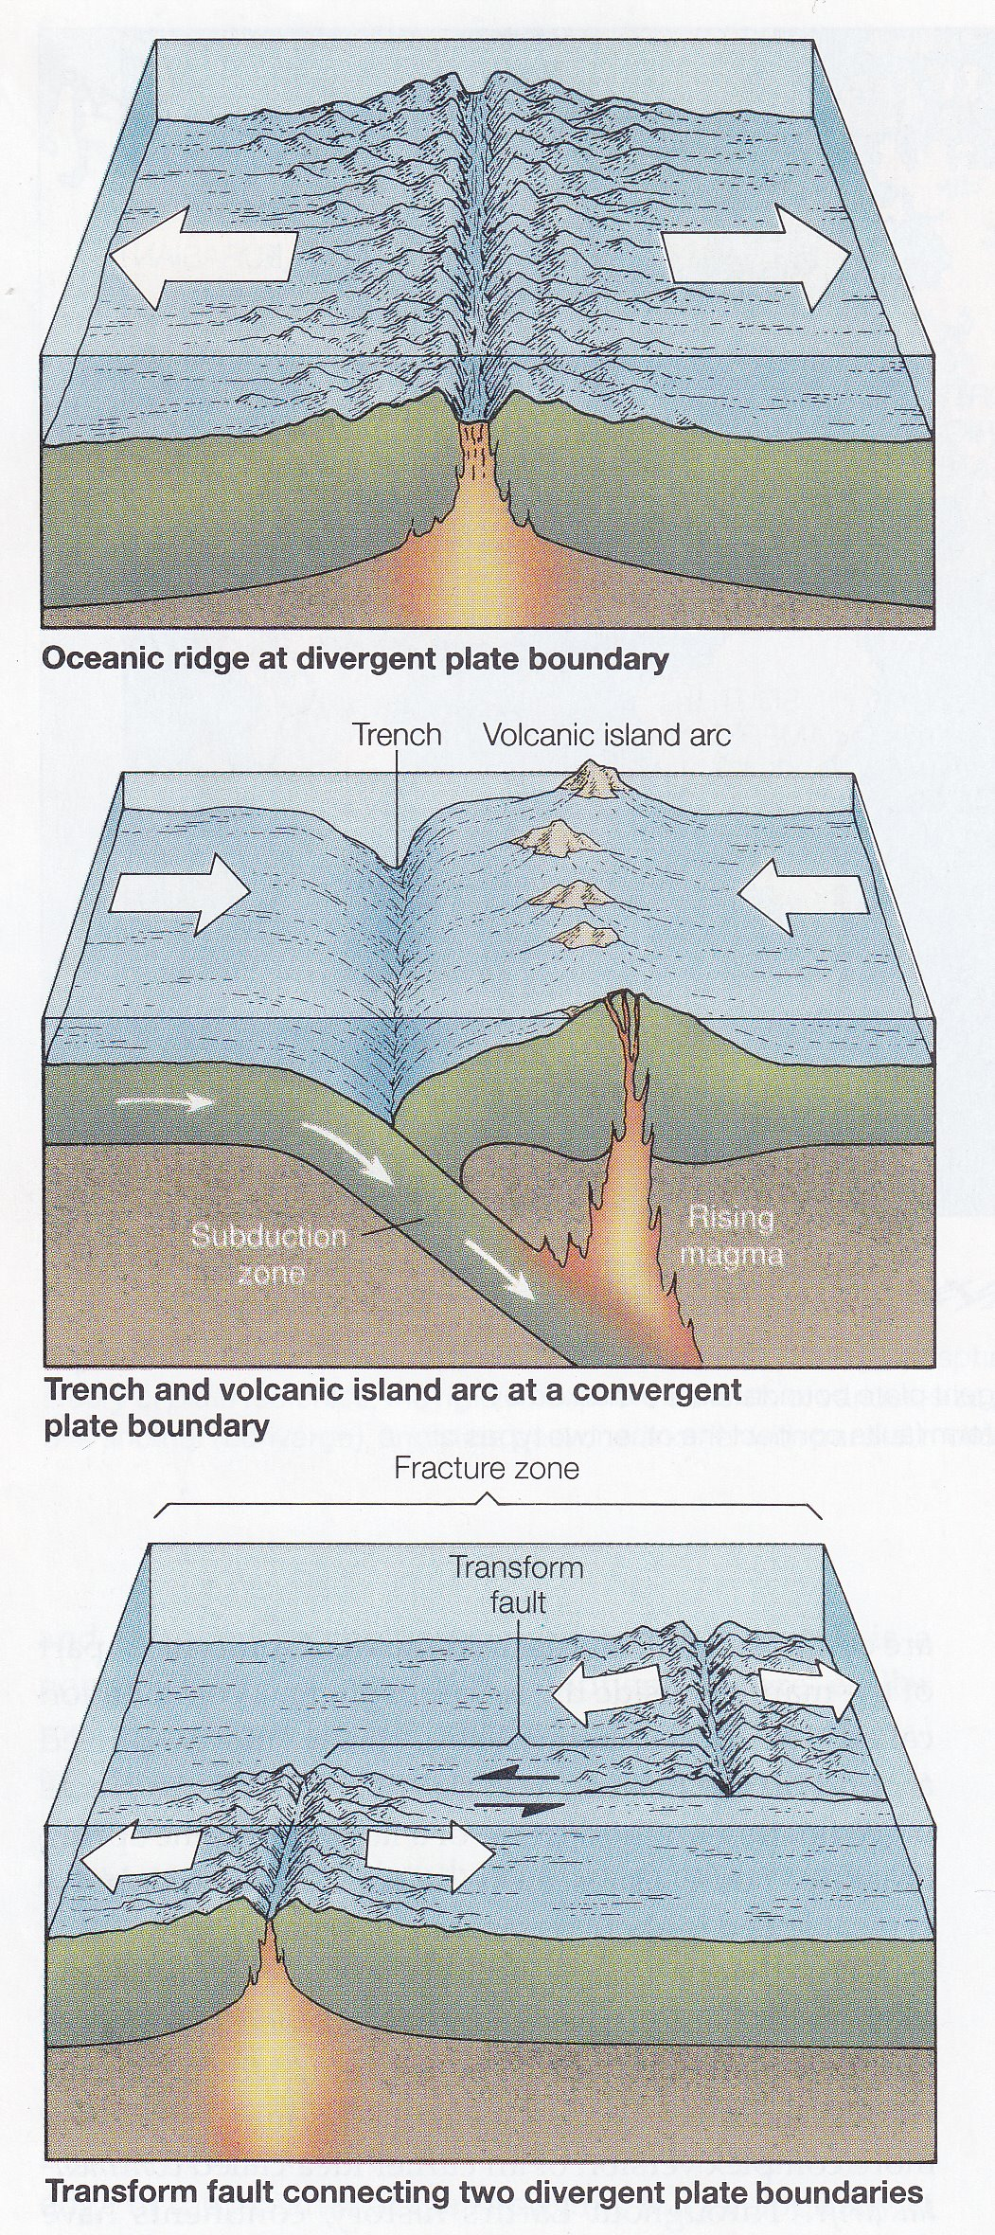
Lithospheric plates have 3 types of boundaries:
Divergent
Convergent
Transform
Figure:
Types of boundaries between Earth’s lithospheric plates.

Slide 13
Biosphere

Slide 14
Zone of the Earth where life is found
The biosphere consists of all living things, plant and animal
Cycling of matter in this sphere involves not only metabolic reactions in organisms, but also many abiotic chemical reactions
Also called Ecosphere
Biosphere extends from less than 11 km below sea level to the tropopause, which is less than 17km above sea level.

Slide 15
Human Impacts on Biosphere
Environmental pollution
Habitat removal or damage
Changing the structure and distribution of vegetation and soils
Over exploitation of renewable resources
Introducing exotic organism
Inappropriate disposal of waste
Disturbing the equilibrium of important environmental system

Slide 16
